Slide 1
Preliminary Design Review:
Efficient Solar Panels for Hot Water
Team 21
Stanley Nguyen, Hal Levin, Moises Bensadon
21
Prof Robert Kotiuga

Slide 2
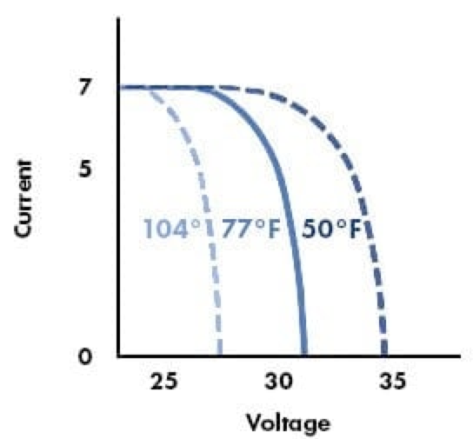
Efficient Solar Panels for Hot Water
21
Prof Robert Kotiuga
Problem statement:
Solar panels are 15-22% efficient in optimal conditions and decrease in efficiency as temperature increases
How can circulated water be used to increase a solar panel’s power production efficiency?
Design and build an efficient, low maintenance solar panel that can be connected to an existing water heating system

Slide 3
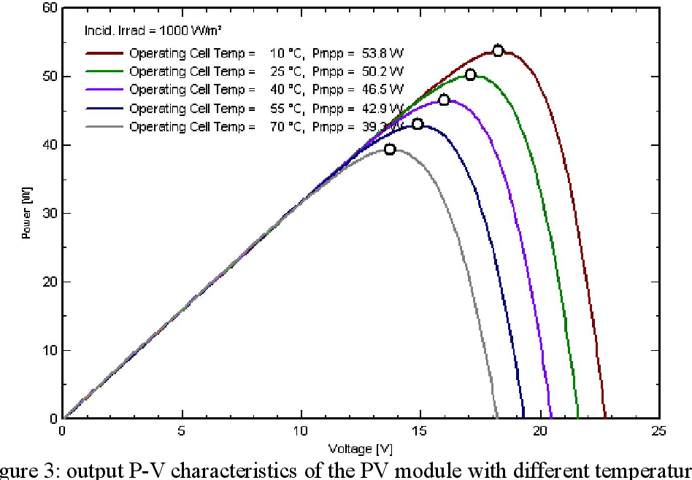
Efficient Solar Panels for Hot Water
21
Prof Robert Kotiuga

Slide 4
21
Prof Robert Kotiuga
Functions and Objectives
Monitoring system must record temperature of solar panels and voltage across solar panels
Automatically trigger water pump to cool solar panels when temperature exceeds optimal operating temperature

Slide 5
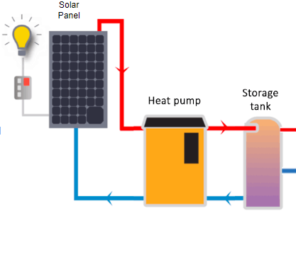
Efficient Solar Panels for Hot Water
21
Prof Robert Kotiuga
Visualization
Home
⚡️
Home

Slide 6
21
Prof Robert Kotiuga
Deliverables
Model energy production against temperature using collected data from our solar panels
→ Determine optimal operating temperature
Build physical system that drives cool water from heat pump to cool the solar panels
Compare and model different designs of this system using data collected on energy use and production by this system

Slide 7
21
Prof Robert Kotiuga
System Diagram
Solar Panel
Home
⚡️
Arduino
Trigger pump
Log temperature and power generation
Web Server to monitor and track metrics
PUMP
Relay
Tank

Slide 8
21
Prof Robert Kotiuga
Design
Tubing Material
For our initial prototype, we chose to use plastic tubing because it’s easily malleable and inexpensive
For greater conductivity and durability, we intend to use copper tubing in our next version
Distribution of tubing
We want the tubing to be distributed in a uniform manner to ensure consistent cooling across solar cells (currently we have a spiral distribution since the plastic tubing doesn’t bend well)

Slide 9
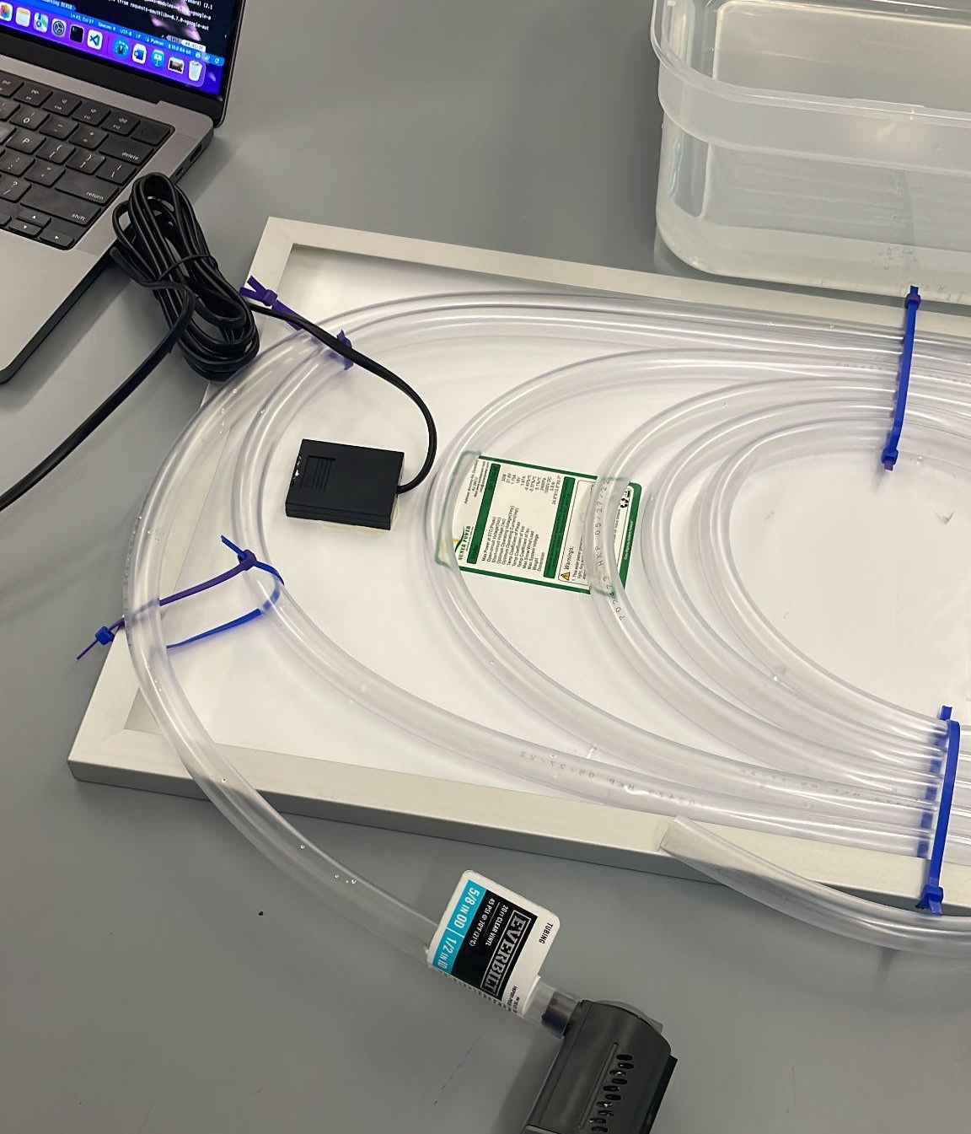
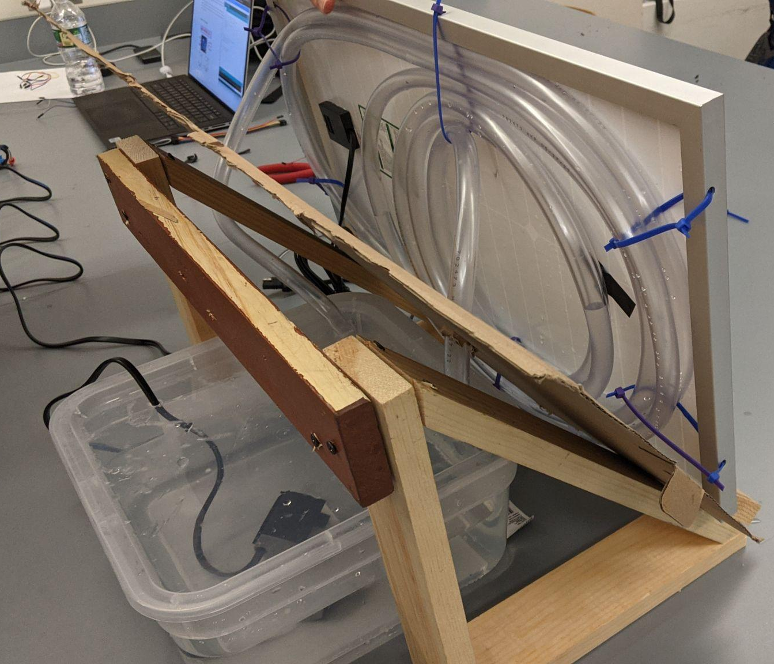
21
Prof Robert Kotiuga
Design

Slide 10
21
Prof Robert Kotiuga
Design
Connectivity
Since this is a residential product, we want the device to be easy for end users to manage.
Bluetooth will be impractical for viewing dashboard but could be useful for triggering the pumps. Have one arduino indoors that connects to another Bluetooth (works well if low wifi range on roof)
Wifi or Ethernet (to indoor arduino) would be ideal to connect Arduino and launch web server to view metrics. This would provide internet access: time syncing, weather predictions, live local price of electricity

Slide 11
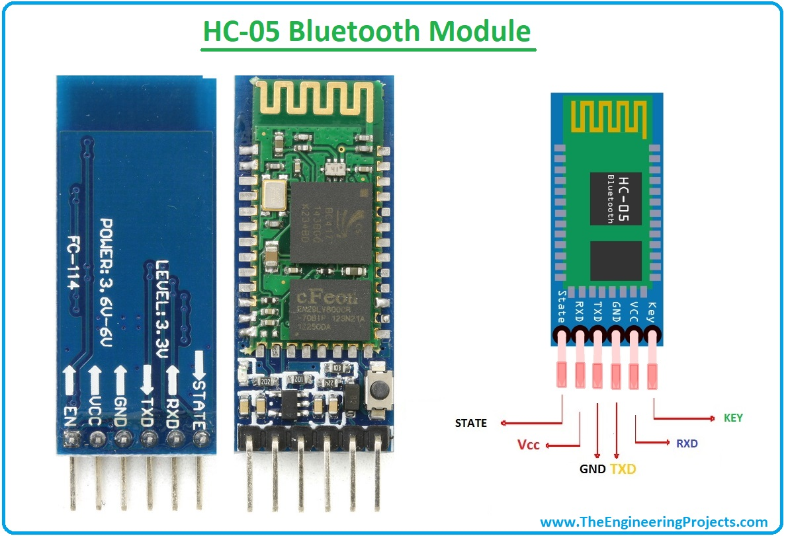
21
Prof Robert Kotiuga
Bluetooth Connection
Input Voltage: 3.3-6V
Effective Transmission
Distance: ~10 Meters
Effective baud rate of 9600 with full duplex support

Slide 12
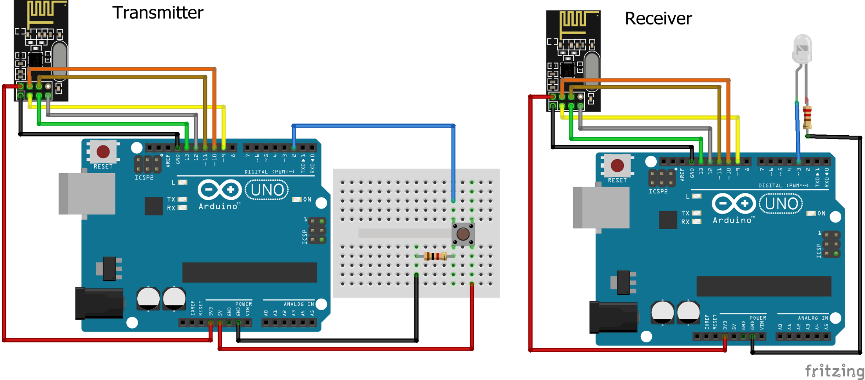
21
Prof Robert Kotiuga
nRF24L01 Radio Module
2.4GHz Band Operation at 2Mbps data rate
Supply Range: 1.9 - 3.3V
Range up to 1 km

Slide 13
21
Prof Robert Kotiuga
Reach Goals
Model systems of different climates such as those that reach freezing temperatures
Use infrastructure to raise the temperature of solar panels in the winter to increase efficiency or to melt snow off of panels
Build customer friendly monitoring system

Slide 14
21
Prof Robert Kotiuga
Gantt Chart
Description | 10/1/22 | 10/10/22 | 10/20/22 | 11/1/22 | 11/10/22 | 11/20/22 | 12/1/22 | 12/10/22 | +++
Research efficiency gains by cooling solar panels
Determine solar panel + tubing choice
Temperature Trigger
Build mount
Water Pump + Relay
Log temperatures, current & voltage
Bluetooth interaction
Web Dashboard
Electricity grid pricing
Hot water routing

Slide 15
21
Prof Robert Kotiuga
Thank you
Questions/Comments

